Slide 1

MOTOR INSURANCE
While you invest your best in eyeing that perfect car , we will invest our best to offer you the perfect cover to protect your vehicle against financial liabilities arising out of unforeseen contingencies.

Slide 2

TYPES OF PRODUCTS
OWN DAMAGE COVER: Designed to protect the insured and the insured’s vehicle from unforeseen damages and losses.
THIRD PARTY LIABILITY COVER : When the policyholder collides with the car of a third party leading to death or bodily injury to the third party, the liability to third party is covered by the insurer.
COMPREHENSIVE COVER: This policy covers both third-party liabilities and damages to the insured own vehicle. Customization of car insurance further by opting different add-ons and covers that would give a car better coverage.

Slide 3
BENEFITS AND HIGHLIGHTS
Use of OEM (original equipment manufacturer) parts for accidental repair claims.
Bundled branded insurance and finance products.
24x7 dedicated Call Centre for intimation of claims and other related services.
Cashless Services across India.
Fast and simple processing for customers without additional work and expenses.
Better and extensive coverages.
Online renewal facility for customers.

Slide 4
COVERAGES
Fire, Explosions , Self-Ignition & Lightning- Your insurance covers damages caused to your car due to fire, explosions or lightning.
Accident caused by external means- In case you are injured due to an accident involving your insured car, your insurance covers the medical expenses.
Man made calamities such as theft, burglar, riots & strikes, malicious acts & terrorism- If the car suffers loss due to man made or natural calamities, your insurance covers the loss.
Natural calamities such as earthquakes, floods, typhoons, hurricanes, storms, cyclones- terrorism- If the car suffers loss due to natural calamities, your insurance covers the loss.

Slide 5
While in transit by rail, road , water or airway- It is a simple and convenient mode of covering the risk of business goods or personal belongings of the insured's while in transit by rail, road, water or airway.
Third party legal liability- Your insurance covers injury or damage to third party or party’s property caused due to the insured car
Cover for an owner driver in case of death- In the unfortunate event of your death arising out of an accident while traveling in our car, we will pay the specified Sum Insured to your legal heir.
Land slide/ rock slide- An accident arising because of collapse of a mass of earth or rock from a mountain or cliff will also be covered under our insurance policy.

Slide 6
.
CHANNELS OF DISTRIBUTION
INDIRECT CHANNELS:
Insurance brokers
Reinsurance brokers
Independent financial advisors
Managing general agents
Retail organizations
Broker networks
DIRECT CHANNELS:
Call centres
Insurance agents
Lloyd’s agents
Mutual organisations
NOTE: DATA OF COMPANY’S PARTNERS WAS NOT AVAILABLE SO THESE ARE COMMON CHANNELS

Slide 7
DATA ANALYSIS

Slide 8
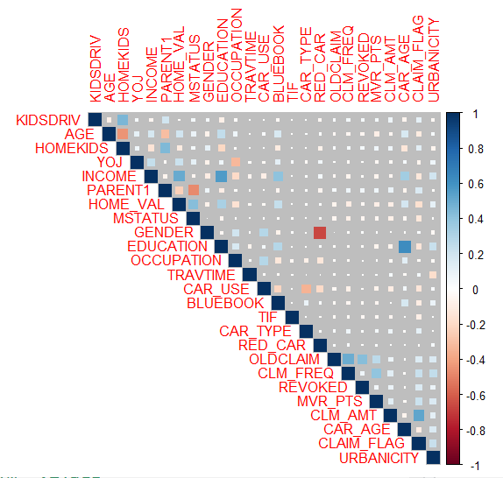
CORRELATION COEFFICIENT
There is a strong positive correlation between education and car_age.
Whereas there is a strong negative correlation between gender and red_car.
There is a strong correlation of income with education and home value because the more qualification will increase income hence better standard of living which rises the home value . TIF has almost no correlation or weak correlation with all variables.

Slide 9
RISK V/S RATING PARAMETERS
RISK PARAMETERS –Risk parameters are used to provide common and consistent criteria for comparing the various risks to be managed.
RATING PARAMETERS - Rating parameters are parameters which one considers for pricing of the product. All rating parameters are risk parameters but all risk parameters need not be rating parameter.
CLM_FREQ
OLDCLAIM
MVR_PTS
URBANICITY
CLAIM_FLAG
TRAVTIME
CAR_USE
CAR_TYPE
OLDCLAIM
CLM_FREQ
REVOKED
MVR_PTS
CLM_AMT
CAR_AGE
CLAIM_FLAG
URBANICITY
YOJ
NOTE: OCCUPATION is also a risk parameter, but in our data there is no risky occupation. Therefore we haven’t put in the Risk parameter

Slide 10
PREMIUM CALCULATION
Your car insurance premium is calculated based on several factors such as-
Car Manufacturer and Model
Cubic capacity (cc)
Age of the Car
Insured Declared Value (IDV)
No Claim Bonus (NCB)
Tax
Insured Declared Value (IDV) is the maximum Sum Assured fixed by the insurer which is provided on theft or total loss of vehicle. Basically, IDV is the current market value of the vehicle. If the vehicle suffers total loss, IDV is the compensation that the insurer will provide to the policyholder.
IDV = Showroom price of your car + cost of accessories (if any) – depreciation value as per (IRDAI)
Loss cost is total cost/policy that company will end up paying as claims. Thus, loss cost is product of probability of claim (frequency) and the average amount to be paid per claim (severity).
Target loss cost (50%) = premium(100%) - expense(50%)
Own Damage Premium is the price you pay for the OD insurance. The premium price for the same is usually determined based on the type of vehicle own; how old it is and the city used it in.
Own Damage premium = IDV X [Premium Rate (decided by insurer)] + [Add-Ons (e.g . bonus coverage)] – [Discount & benefits (no claim bonus, theft discount, etc.)]

Slide 11

To protect you and your car in case of any damages due to unavoidable situation and accident events
OPTIONAL EXTENSIONS
PRIVATE CAR POLICY:
ENGINE SECURE
ZERO DEPRECIATION
DAILY ALLOWANCE
CONSUMABLES COVER
NCB PROTECTION
ROADSIDE ASSISTANCE
DEPRECIATION REIMBURSEMENT
PANDEMIC PROTECTION COVER

Slide 12
OPTIONAL EXTENSIONS
TO PROTECT YOU AND YOUE COVER IN CASE OF ANY DAMAGES DUE TO UNAVOIDABLE SITUATIONS & ACCIDENT EVENTS.
COMMERCIAL CAR POLICY:
Engine Protection Cover
NCB PROTECTOR
Invoice Protection
Roadside Assistance Cover
Consumable Cover
Zero depreciation
Personal Accident Insurance for Passenger

Slide 13
UNDERWRITING
Underwriting occurs when an insurer and an insured conclude a contract of insurance, whereby the insurer undertakes to protect the insured against losses due to specific future risks, while the insured has the obligation to pay periodic premiums to the insurer in return. The underwriting process concerning motor vehicle is a lengthy and detailed process which should be well-planned. The underwriting factors relate to the particulars of the proposer, as well as the details concerning the motor vehicle.
UNDERWRITING FACTORS
1. Age of the proposer. 6. Particulars of the motor vehicle
2. Gender of the proposer. 7. Time travel
3. Marital status of the proposer. 8. Old claim (Driving record).
4. Address of the proposer/Location 9. Use of motor vehicles
5. Occupation 10. Driving history (Motor vehicle record Points)

Slide 14
FRAUDS CONTROL
Fraud in insurance is defined as “an act or omission intended to gain a dishonest advantage for the fraudster or for the purpose of other parties”.
Approaches to Detect Fraud Claims in Motor Insurance:
(a) Predictive Modelling to Detect Fraud and Control Claim Cost.
(b) Preliminary Investigation by Experienced and Efficient Front Office Claims Handlers.
(c) Sophisticated Databases to Detect Fraud.
(d) Using Technology to Detect and Control Fraud.
HOW WE CONTROL FRAUDS:
Implement a foundational framework.
Know the relative level of fraud potential.
Use data analytics to detect fraud.
Continually review and rescore claims.

Slide 15
CLAIM SETTLEMENT PROCESS
Intimation by Insured for accidental loss to subject matter of Insurance Registration of Claim by Insurer
Deputation of Surveyor / Investigator for assessment of liability of Insurer.
Assessment and submission of Survey report by Surveyor.
Scrutiny of Claim file .
Letter to Insured regarding assessment of loss and to submit required information/papers.
Approval of Claim by the Competent Authority, after receiving the complete information / papers.
Settlement of Claim.

Slide 16
CLAIM SETTLEMENT DOCUMENTS
Apart from claim form and Survey report the other documents required for processing the claim are:
• Driving License
• Registration Certificate Book
• Fitness Certificate (Commercial Vehicles)
• Permit (Commercial Vehicles)
• Police Report (Taxis, commercial Vehicle need F.I.R./ spot survey if loss is heavy or T.P. loss occurs)
• Final Bill from repairers
• Satisfaction Note from the insured
• Receipted bill from the repairer, if paid by insured.
• Discharge voucher (full and final payment)

Slide 17
EXCLUSIONS
Normal wear and tear and general ageing of the vehicle.
Damage to/by a person driving any vehicles or cars without a valid license.
Vehicles including cars being used otherwise than in accordance with limitations as to use.
Depreciation or any consequential loss.
Damage to/by a person driving the vehicle under the influence of drugs or liquor.
Loss/ damage due to war, mutiny or nuclear risk.
Driving the vehicle against the limitations as to use.

Slide 18
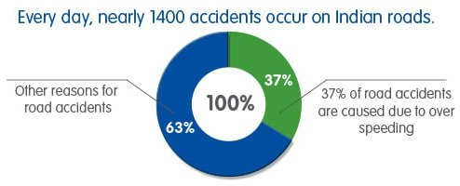
Not sure if you need car insurance? Numbers Don’t Lie!
The poor road conditions and a blatant disregard for traffic regulations make Indian roads one of the most dangerous in the world.
These fatalities are only expected to rise in the future. We don't mean to scare you by these grim statistics. The statistics reflect the kind of dangers that the roads entail. Hence, It's better to be safe than sorry!

